Slide 1
Azure Project
Accelerating Analytics with Azure Synapse and ADF

Slide 2
Project A(Azure Synapse Analytics)
Cosmos DB:
A powerful global database for fast and scalable applications, handling all sorts of data types.
Blob Storage:
Blob Storage is a scalable solution for storing all types of unstructured data, like images and documents.
Data Lake Gen2:
Data Lake Gen2 is a powerful storage system, perfect for storing and analyzing massive amounts of raw data.

Slide 3
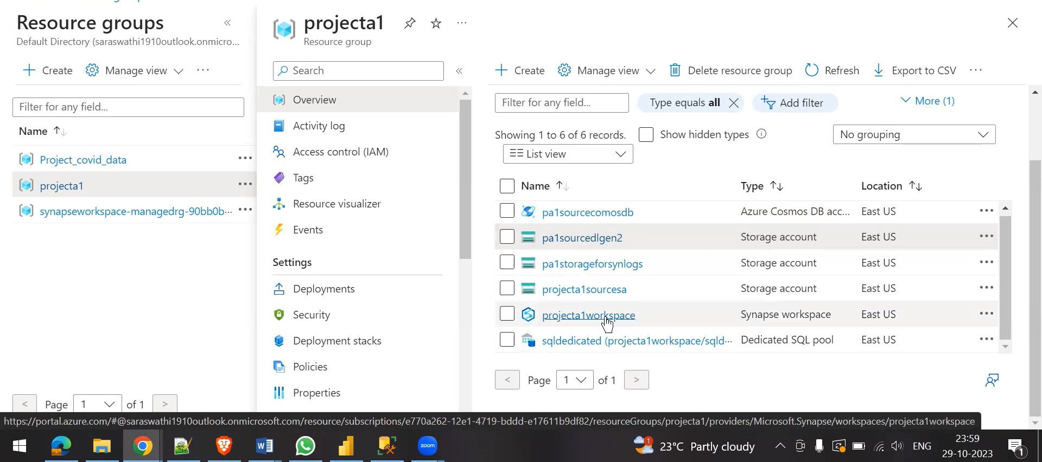

Slide 4
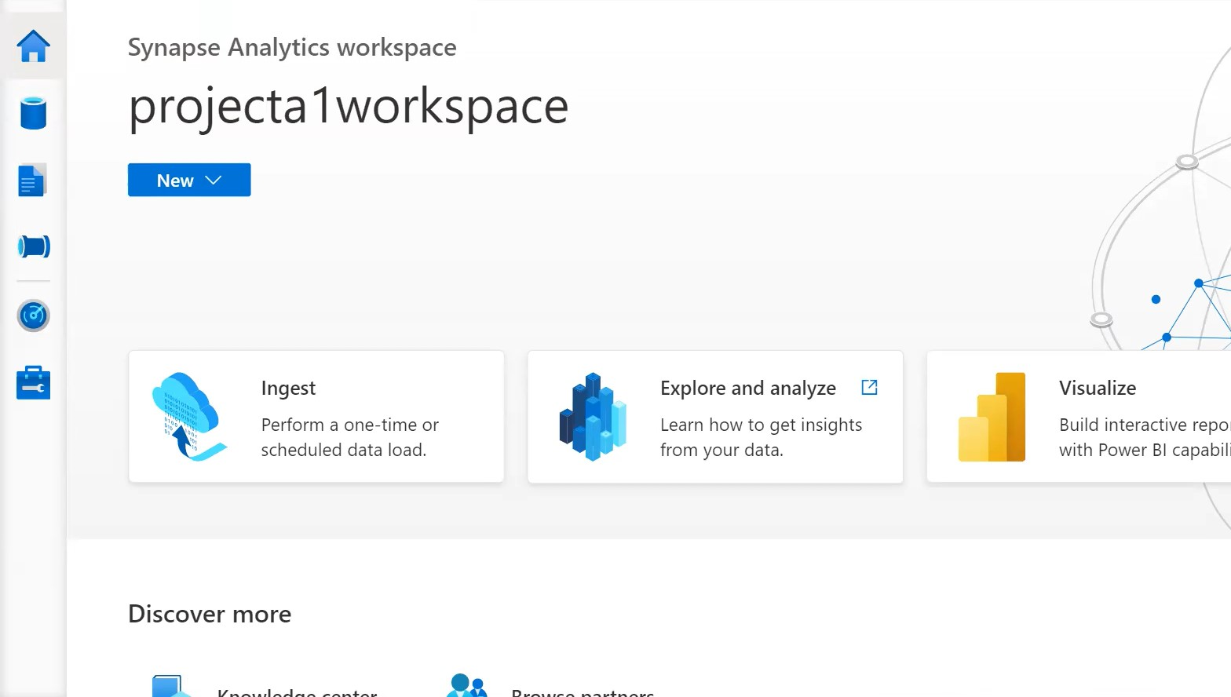
Synapse Workspace

Slide 5
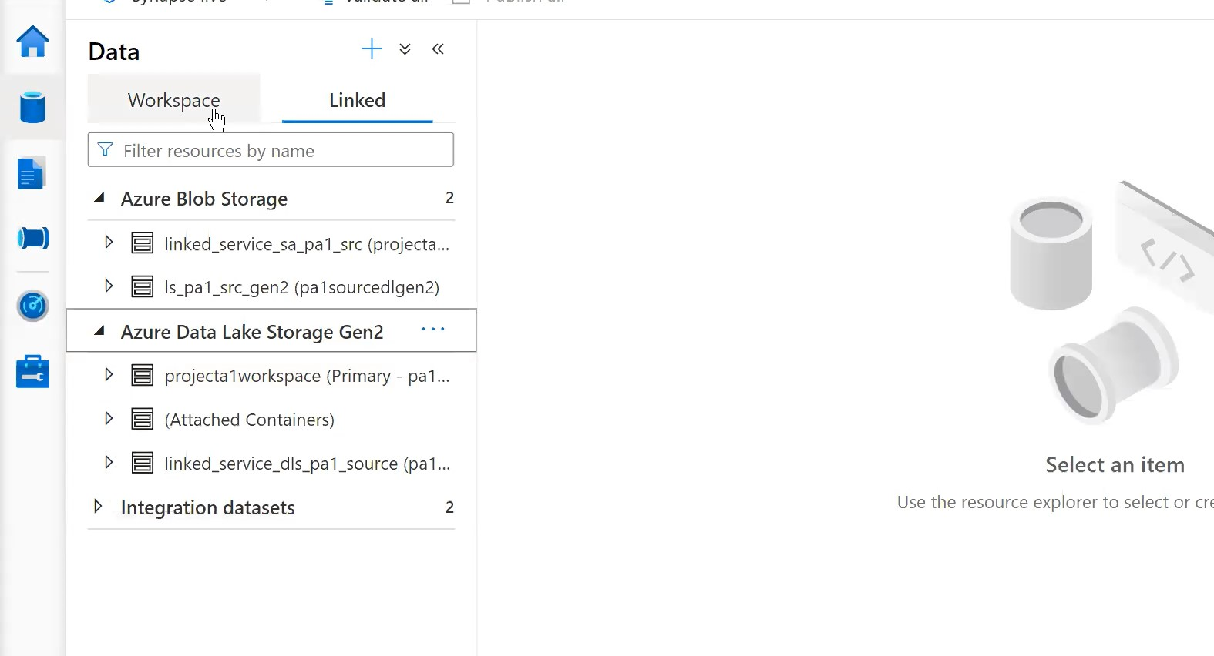

Slide 6
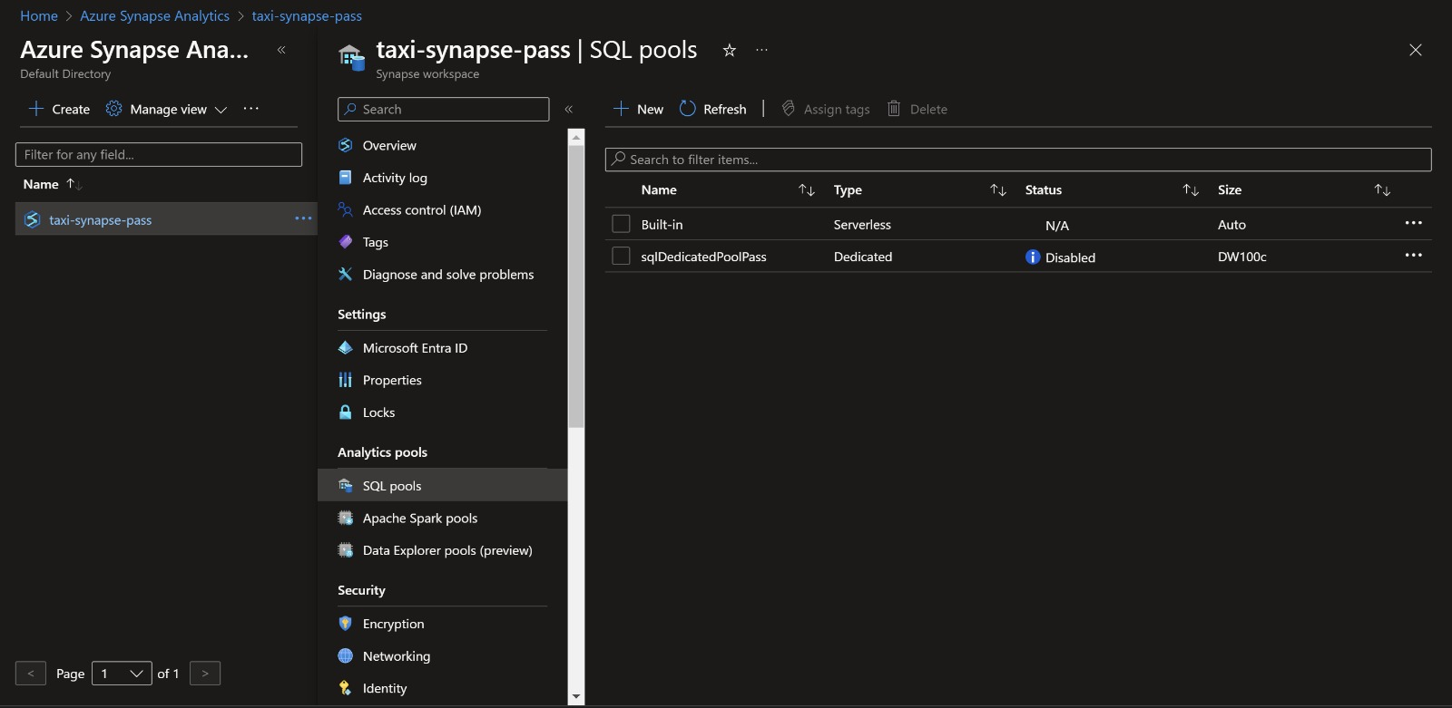

Slide 7
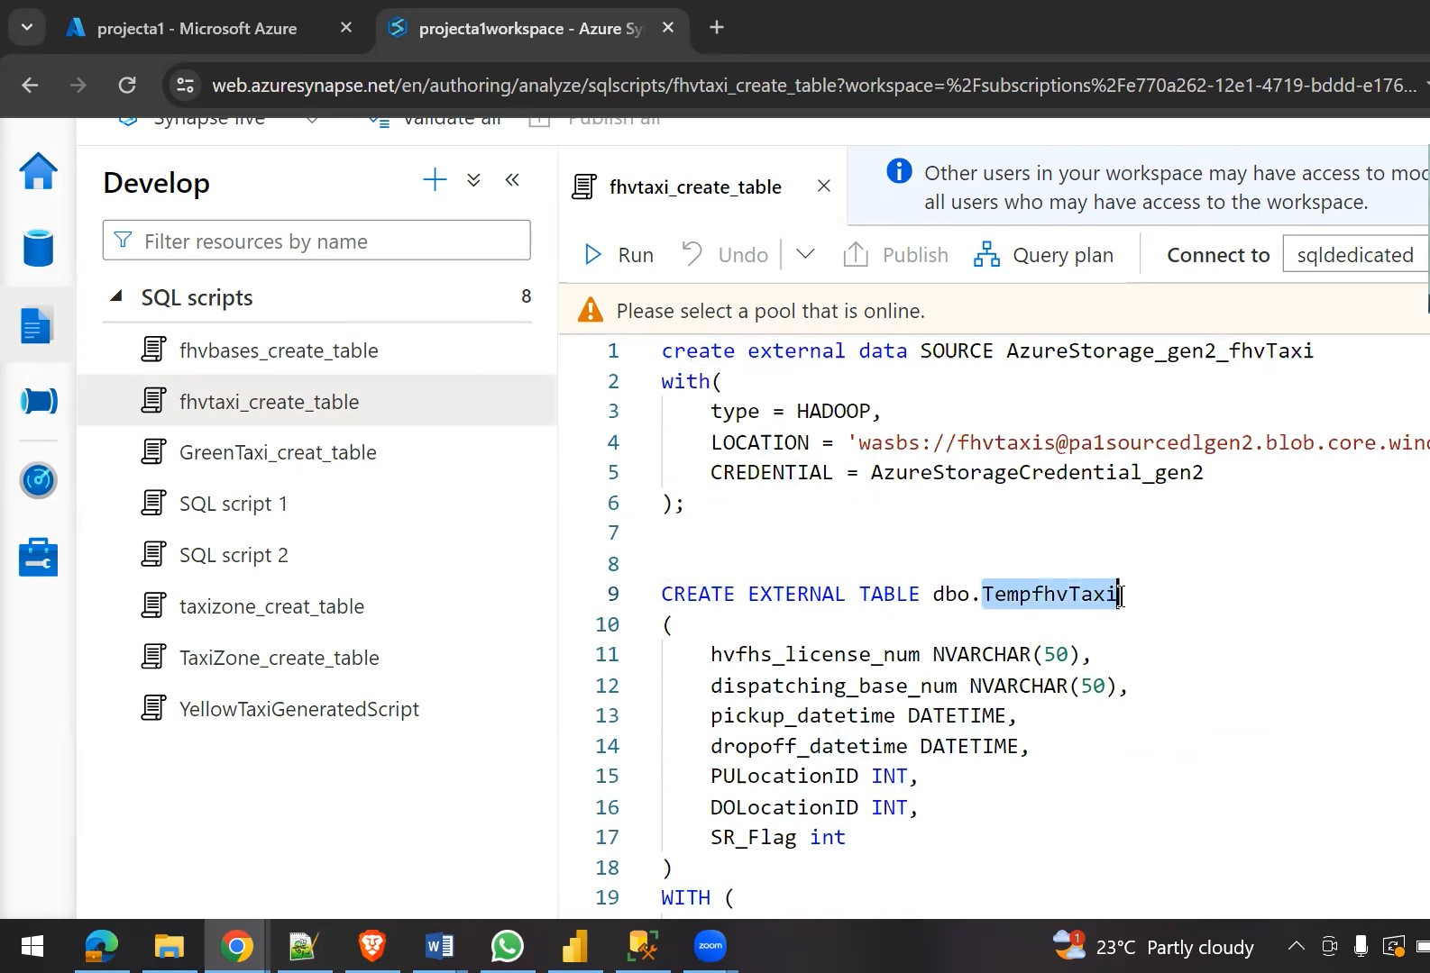

Slide 8
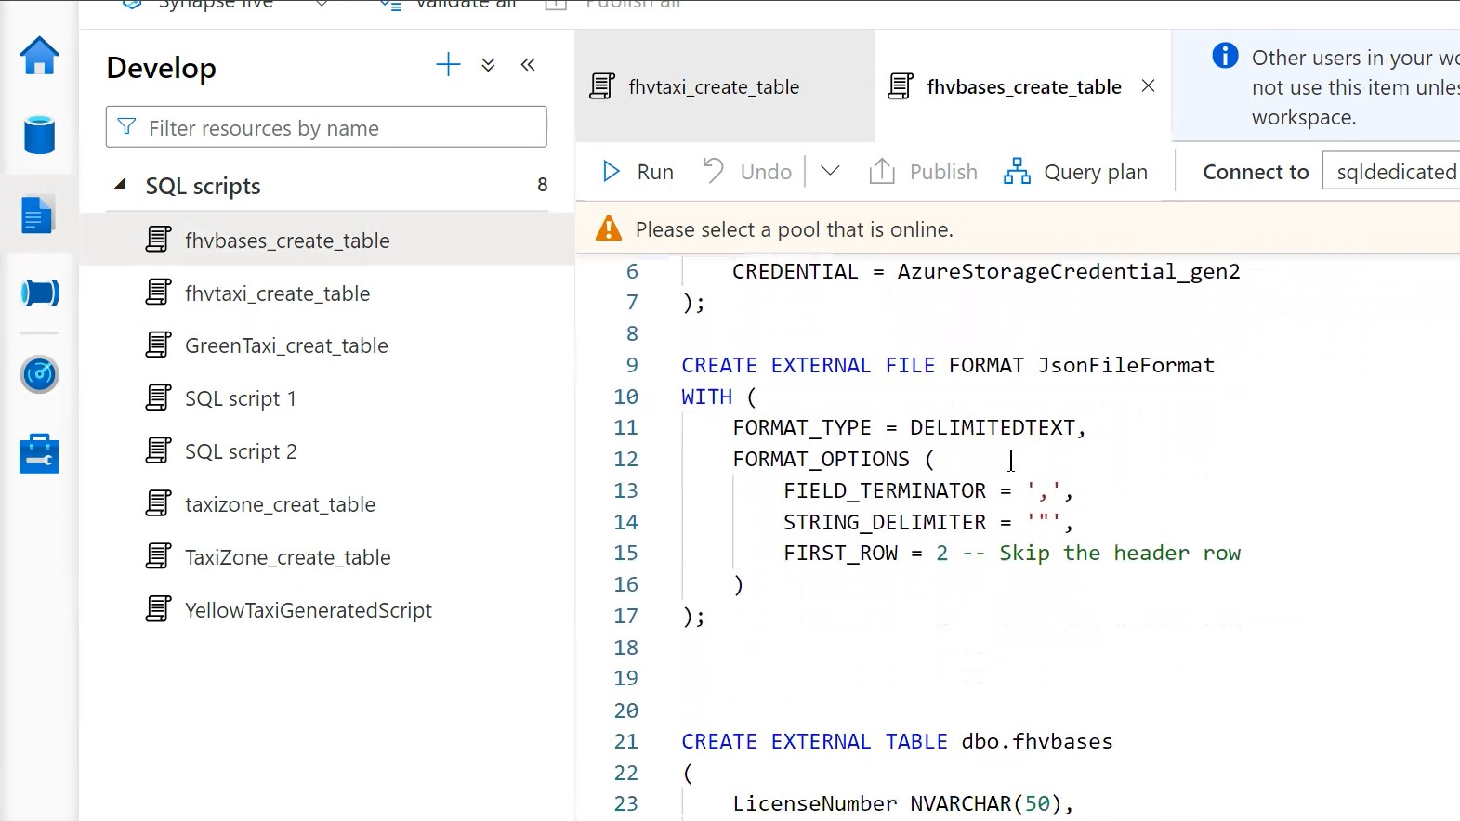

Slide 9
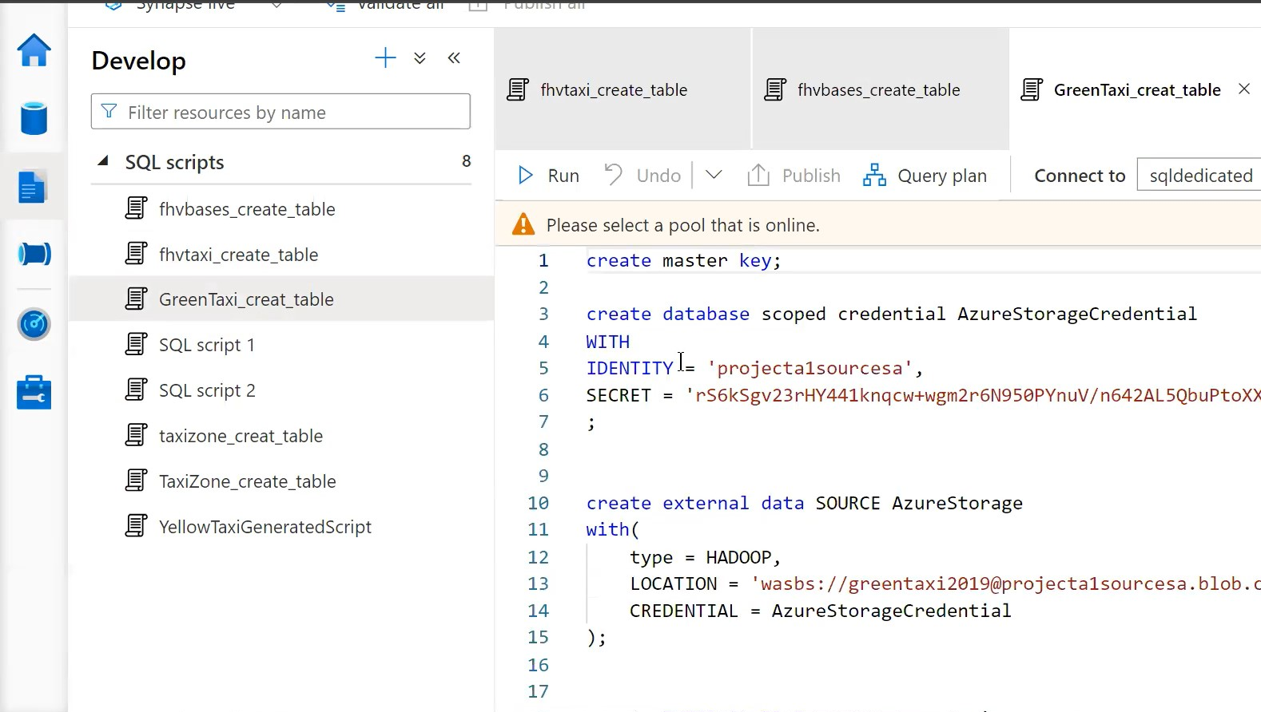

Slide 10
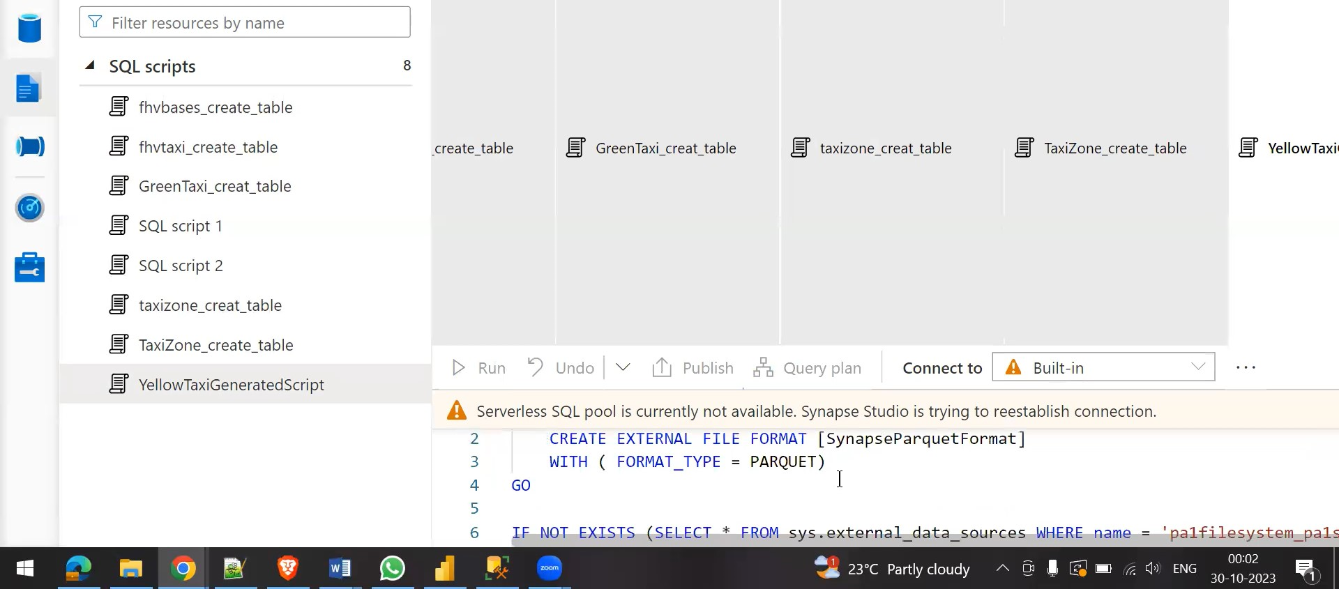

Slide 11
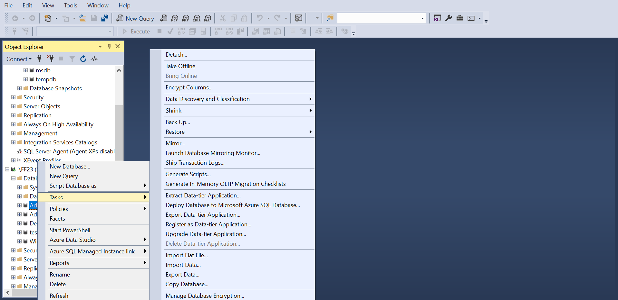
Project B(Azure data factory)

Slide 12
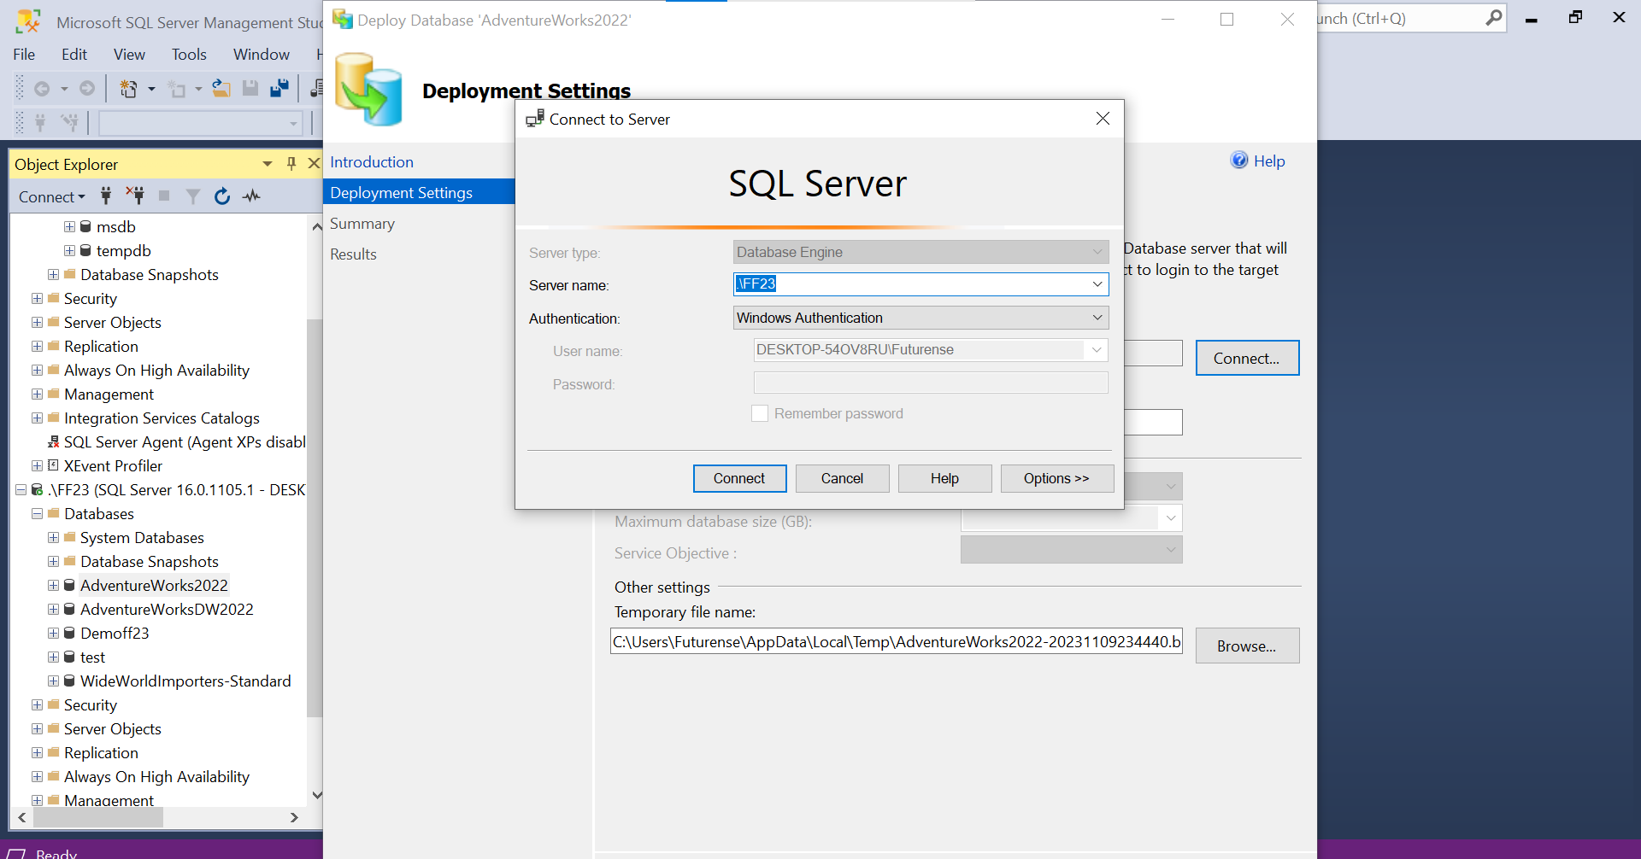

Slide 13
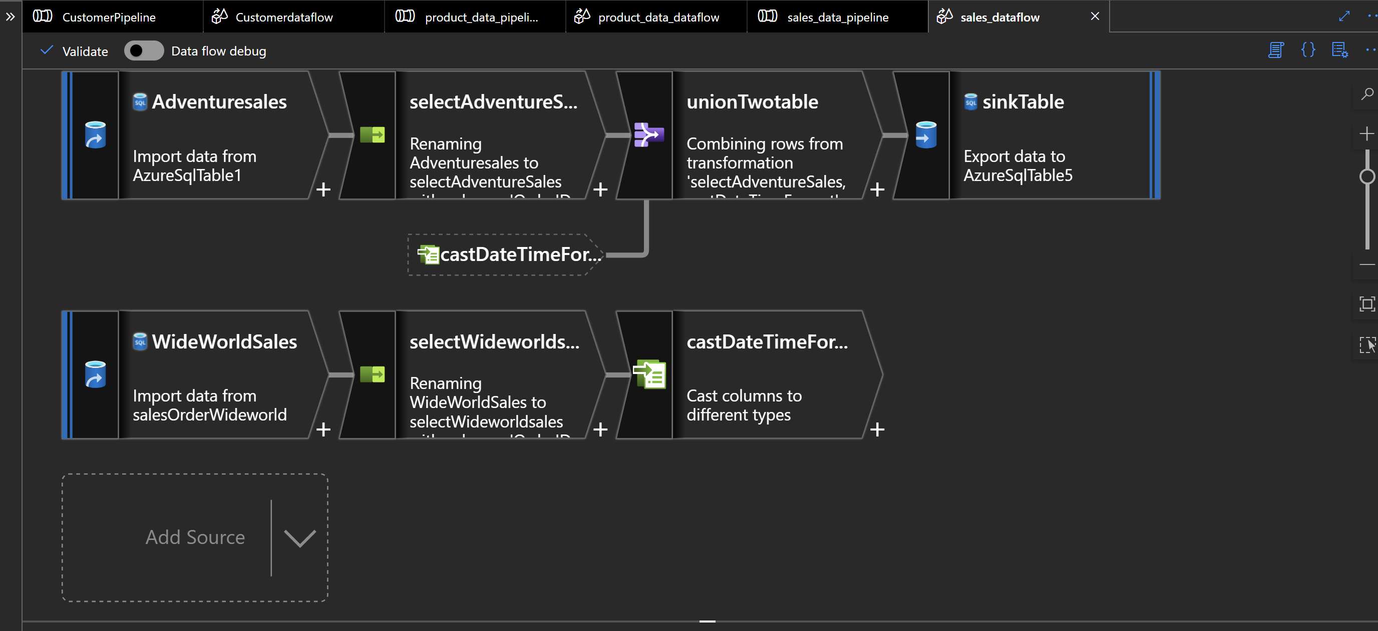
Sales Data

Slide 14
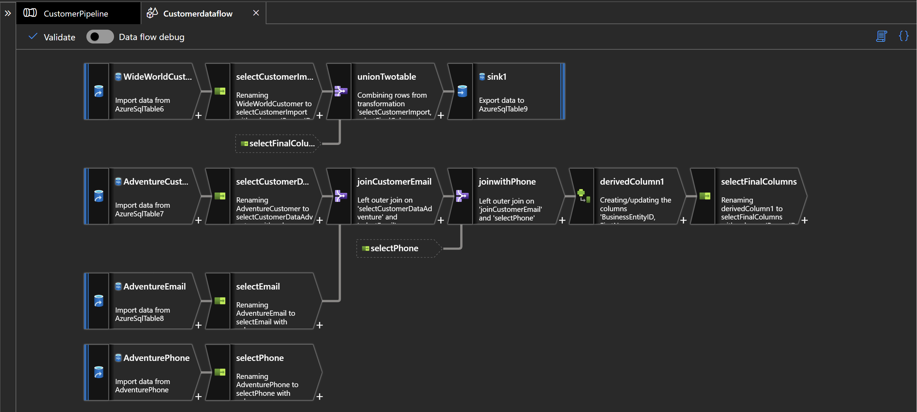
Customer Data

Slide 15
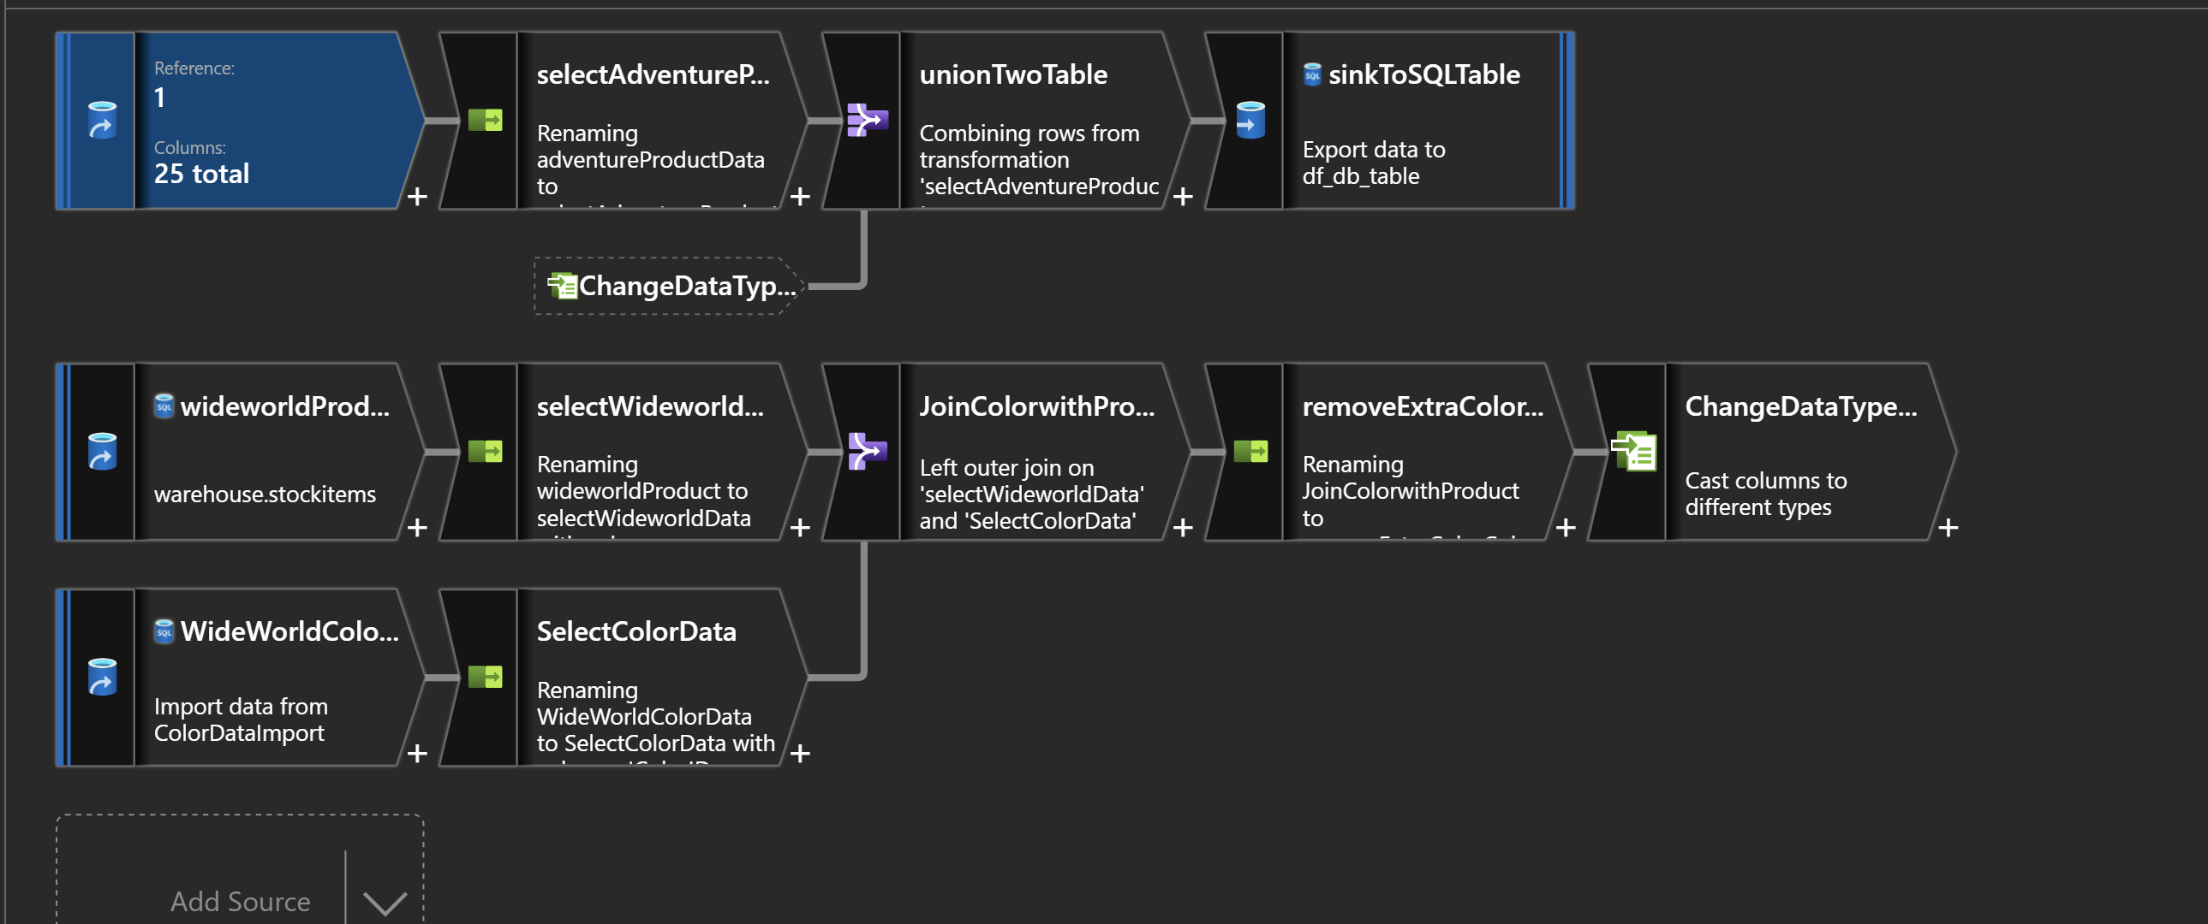
Product data

Slide 16
Challenges
Access Issues with Cosmos DB in Project A
Selecting Specific Columns in Project B Data Flow Pipeline
Limited Access and Resource Constraints with Shared Azure Account

Slide 17
Thank you

